Slide 2
Introduction to Azure Databricks
Jan Remko Yntema
Data Architect
ilionx
jryntema@ilionx.com

Slide 3
A short history or Spark and Databricks
2003 – Google file system paper released – Implemented as HDFS
2004 – MapReduce paper released
2006 – Release of Hadoop
2012 – Release of Spark
2013 – Foundation of Databricks

Slide 4
Hadoop vs. Spark
Hadoop is disk-orientend
Vs.
Spark is memory-oriented

Slide 5
Key concepts of Spark
Build in Scala
RDD Resilient Distributed Dataset - readonly
Spark DataFrame – Imposes structure on data, resembles pandas DataFrame
Spark Dataset – stores metadata, so the catalyst engine gets information on how to optimize a job

Slide 6
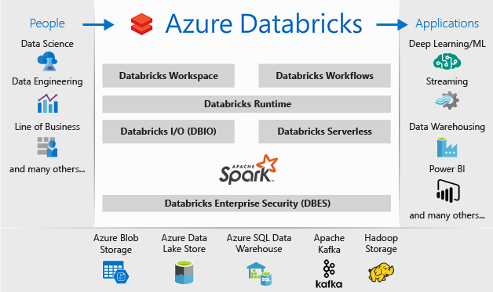
Databricks Framework

Slide 7
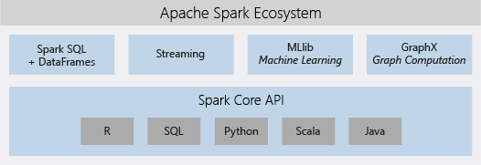

Slide 8
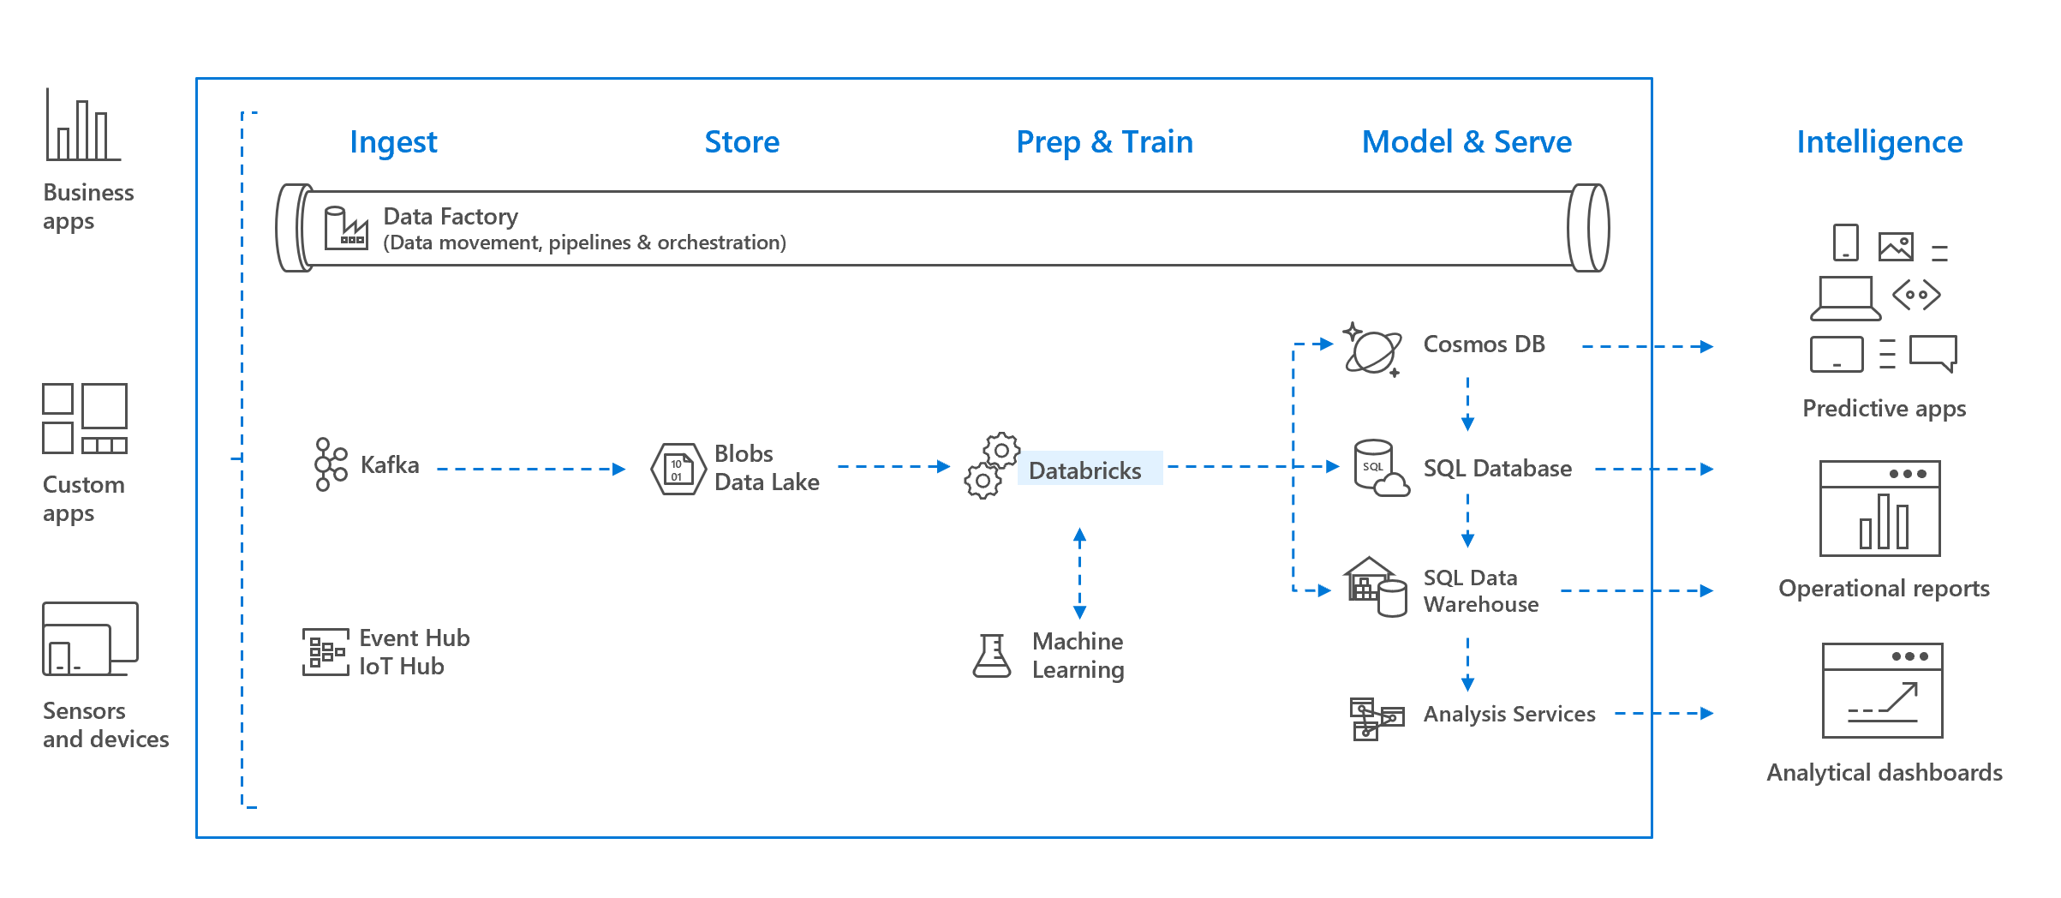
Databricks in the MDW

Slide 9
Databricks Delta or Delta Lake
Delta lake is a storage layer on top of a data lake
It provides
ACID Transactions
Metadata handling
Unifies streaming and batch processing

Slide 10
Q&A

